Slide 1

Augmented Academia
Dr Alisha Aman
ECLBio committee
MVLS GAINEd steering committee

Slide 2
Agenda
10 mins: Brief introduction to GenAI and prompts
30 mins: Hands-on practice in groups
10 mins: Q&A troubleshooting
10 mins: Ethics

Slide 3
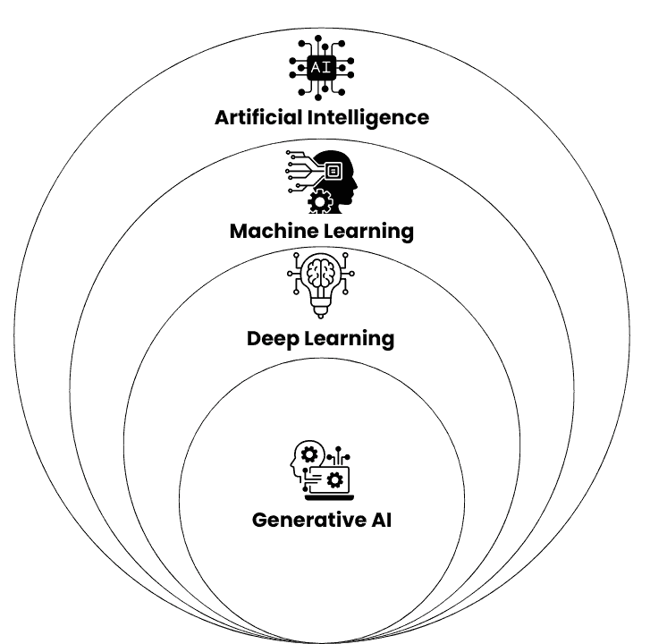
What is GenAI?
AI-based tools that can create new content based on your instructions.
This content can be text, images, code, video, or audio.
Don’t confuse all AI tools with GenAI
Generative AI vs Traditional AI: Key Differences in ML and DL

Slide 4
How can it help?
Tool
Copilot Chat (Edge) | Ask anything with enterprise-protected data
Word Copilot | Draft papers, rewrite paragraphs, cite sources
Excel Copilot | Summarise data, generate charts, run Python quick-analysis
PowerPoint Copilot | Build slide decks from outlines & add speaker notes
Teams Meeting Recap | Instant transcript, tasks & smart summary
Clipchamp AI | Auto-edit lab demo videos
Image Creators | Generate licence-free scientific diagrams
Viva Insights | Personal productivity coaching via GenAI

Slide 5
Guardrails
Never upload to public AI
Always disclose AI-use
Don’t trust unknown sources
Always verify

Slide 6
Prompts
Prompts
A prompt is the instructions, questions, or requests you give to an AI system:
It’s how you communicate what you want the AI to do
A good input = A good output
🎯 Be specific
📏 Set boundaries
🎪 Provide context
📋 Request format
🔄 Iterate
Say exactly what you want
Give word limits, format preferences
Explain the audience and purpose
Ask for lists, tables, paragraphs
Refine your prompt on what you get back

Slide 7
P-T-C-F
Persona
Task
Context
Format
“You are a senior microbiology lecturer.”
“Create a six-week module outline.”
“Second-year students, focus on CRISPR ethics, include BPS learning outcomes.”
“Return a table: Week | Topic | Activity | Reading.”
Example full prompt “You are a senior microbiology lecturer. Draft a six-week module outline on CRISPR ethics for second-year students, mapped to British Pharmacological Society outcomes. Format as a table with Week | Topic | Active learning | Reading list.”

